Slide 1
Compressed Air Energy Storage (CAES) for NYS Energy Needs
James Hayes and Reynold Gao
Notes:
Reynold

Slide 2
Objectives
Introduce the principles and state of CAES technology
Analysis and simulation of a CAES process
Evaluate the Finger Lake salt mines for CAES
Describe NYS need for energy storage
Provide our recommendation
Notes:
Reynold

Slide 3
Principles and State of CAES Technology
Notes:
Reynold

Slide 4
Introduction
Variable renewable energy generation is expected to increase significantly in the coming years
NYS is targeting 6,000 MW of solar by 2025 and 9,000 MW of offshore wind by 2035^{[1]}
These electrical generation technologies have short term and seasonal variability
Poor dispatchability and capacity factor
Risk of overgeneration
Energy storage presents a solution to the shortcomings of variable renewables
CAES is one such technology
Electrical energy is input into a gas compressor
High pressure gas is stored in a vessel
Energy can be recovered by running the compressed gas through a turbine
Advantages: high power generation, energy storage capacity, and long storage periods^{[2,3,4]}
Notes:
Reynold

Slide 5
Types of CAES
Diabatic CAES (D-CAES)
Uses an external energy source (natural gas combustion) to reheat air prior to expansion in the turbine
Overall process efficiencies 40-60%^{[5,6]}
Adiabatic CAES (A-CAES)
Heat from the compressed air is recovered and stored
Turbine inlet air is reheated with stored heat
Overall process efficiencies 60-70%^{[5,6]}
Isothermal/Near-isothermal CAES (I-CAES)
Rapid heat exchange during compression and expansion keeps air at constant temperature
Overall process efficiencies 90-95%^{[7]}
Not viable for high air flow rates and power capacities due to limitations in heat exchangers
Notes:
Reynold

Slide 6
CAES Process
E
F
Generator
1
2
B
C
A
D
3
4
Storage Vessel
(e.g., salt cavern)
Figure 1. Simplified CAES process flow diagram. 1: Compressor. 2: Turbine. 3: Cooler. 4: Heater. A: Input Ambient Air. B: Compressor Outlet Air. C: Turbine Inlet Air. D: Output Air. E: Input Compressor Work. F: Output Turbine Work.
Notes:
Reynold

Slide 7
History of CAES
1949: CAES process first patented in the US
1978: First commercial CAES facility commissioned in Huntorf, Germany
1991: Second facility in McIntosh, Alabama
2011: CAES facility considered for Seneca Lake, NY
2022: Two facilities connected to grid in Zhangjiakou and Changzhou City, China
Zhangjiakou facility is A-CAES with 100 MW and 400 MWh capacity
Future facilities (A-CAES)
Gem Energy Storage Facility, Kern County California (2026-2027), 500 MW and 4 GWh capacity
Pecho Project in San Luis Obispo, California, 400 MW and 3.2 GWh capacity
Broken Hill project in New South Wales, Australia, 200 MW and 1.6 GWh capacity
Notes:
Reynold

Slide 8
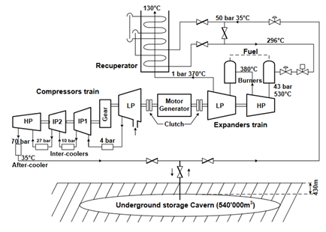
Huntorf and McIntosh CAES
Both are D-CAES
Natural gas burners used to reheat air
Salt domes are used for air storage
Still operating well despite age
Availability is 90%, starting reliability is 99%
Table 1. Specifications of Huntorf and McIntosh CAES facilities^{[8,9]}.
Figure 2. Process Flow Diagram of McIntosh CAES facility^{[10]}.
Process Variable | Huntorf CAES | McIntosh CAES
Nameplate power capacity (MW) | 290 | 110
Compressor rated power (MW) | 62 | 53
Energy capacity (MWh) | 580 | 2,860
Storage Volume (m³) | 310,000 | 560,000
Pressure (bar) | 43-70 | 45-74
Overall Process Efficiency (%) | 42 | 54
Notes:
Jimmy

Slide 9
Analysis and Simulation
Notes:
Jimmy

Slide 10
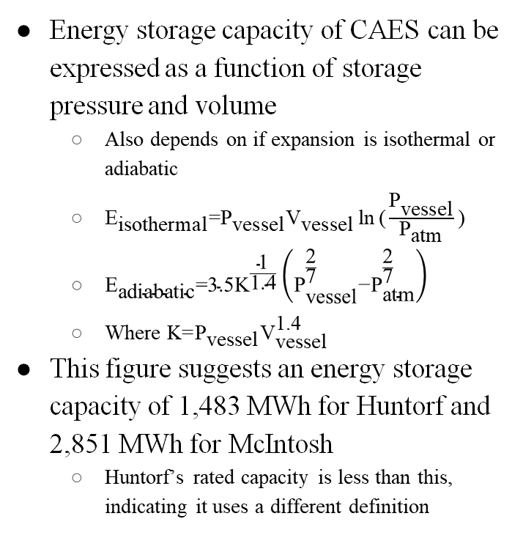
Analysis
Energy storage capacity of CAES can be expressed as a function of storage pressure and volume
Also depends on if expansion is isothermal or adiabatic
${\text{E}}_{\text{isothermal}}\text{=}{\text{P}}_{\text{vessel}}{\text{V}}_{\text{vessel}}\text{ln}{\text{(}\frac{{\text{P}}_{\text{vessel}}}{{\text{P}}_{\text{atm}}}\text{)}}$
${\text{E}}_{\text{adiabatic}}\text{=3.5}{\text{K}}^{\frac{\text{1}}{\text{1.4}}}\left({\text{P}}_{\text{vessel}}^{\frac{\text{2}}{\text{7}}}\text{−}{\text{P}}_{\text{atm}}^{\frac{\text{2}}{\text{7}}}\right)$
Where $\text{K}\text{=}{\text{P}}_{\text{vessel}}{\text{V}}_{\text{vessel}}^{\text{1.4}}$
This figure suggests an energy storage capacity of 1,483 MWh for Huntorf and 2,851 MWh for McIntosh
Huntorf’s rated capacity is less than this, indicating it uses a different definition
Figure 5. CAES energy storage capacity per 100,000 m³ of storage vessel volume as a function of storage pressure. Both isothermal and adiabatic turbines are considered. The ideal gas equation of state is used to model air. An ambient storage vessel temperature of 273K is assumed.
Notes:
Jimmy

Slide 11
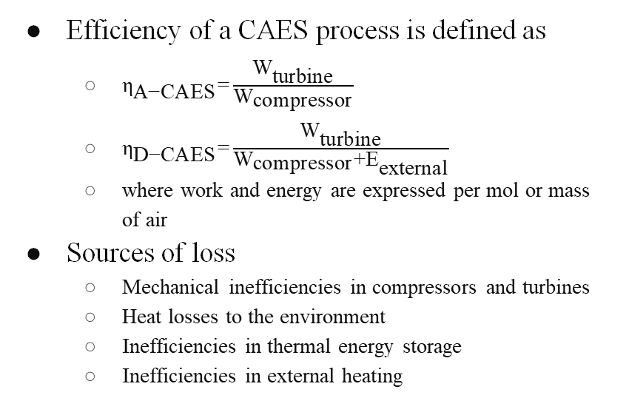
Analysis
Efficiency of a CAES process is defined as
${\text{η}}_{\text{A}\text{−}\text{CAES}}\text{=}\frac{{\text{W}}_{\text{turbine}}}{{\text{W}}_{\text{compressor}}}$
${\text{η}}_{\text{D}\text{−}\text{CAES}}\text{=}\frac{{\text{W}}_{\text{turbine}}}{{\text{W}}_{\text{compressor}}\text{+}{\text{E}}_{\text{external}}}$
where work and energy are expressed per mol or mass of air
Sources of loss
Mechanical inefficiencies in compressors and turbines
Heat losses to the environment
Inefficiencies in thermal energy storage
Inefficiencies in external heating
Figure 6. Overall process efficiency versus reheating temperature for a simplified D-CAES process. An efficiency of 60% is assumed for the natural gas heater.
Figure 7. Overall process efficiency versus reheating temperature for a simplified A-CAES process.
Notes:
Jimmy

Slide 12
Process Simulation
Table 2. Performance of A-CAES process simulations in Aspen Plus V11.
A-CAES process simulations run in Aspen Plus V11
Storage pressure and temperature of 70 bar and 290 K
Two compressors and two turbines in series
Five process simulations were run
Process 1 is used as a baseline
Process 2 considers loss of pressure during storage
Process 3 considers using compressors and turbines with higher isentropic efficiencies
Process 4 considers a less efficient thermal energy storage system
Process 5 considers all the modifications in 2-4
Takeaways:
Thermal energy storage is limiting in overall A-CAES process performance
Loss of pressure during storage has minimal impact on efficiency as long as heat is reinput
Process | Overall CAES Efficiency (%)
1 | 72.3
2 | 68.0
3 | 75.8
4 | 61.4
5 | 61.6
Notes:
Jimmy

Slide 13
Finger Lake Salt Mines for CAES

Slide 14
Advantages of using a salt cavern for CAES
Three primary geological structures can be used for CAES: hard rock, porous rock, and rock salt^{[11]}
Hard rock
High capital cost to create caverns (~$30/kWh)
Common geological feature: less restriction on location
Porous rock
Lowest capital cost at $0.10/kWh
Storage period limited
Salt caverns
Low capital cost at $2-10/kWh
Extensive knowledge from use as petroleum/natural gas storage
Easily formed with solution mining
Notes:
Reynold

Slide 15
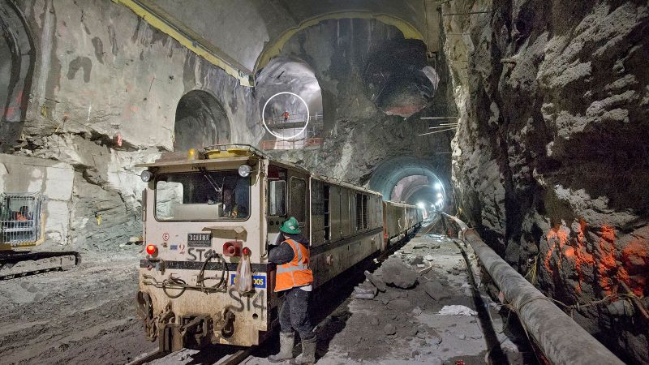
Cayuga Lake Salt Mines
Salt beds created by cyclic geologic processes about 550 million years ago
Since 1970, Cargill Inc. has been mining salt beds beneath Cayuga Lake at a depth of 700 m^{[12]}
Mine workings: 42 ft wide and 10 ft high
Around 57,000,000 m³ of total mine volume
Equivalent to 273 GWh of air stored at 70 bar
Figure 8. Cargill Salt Mine^{[13]}.
Notes:
Reynold

Slide 16
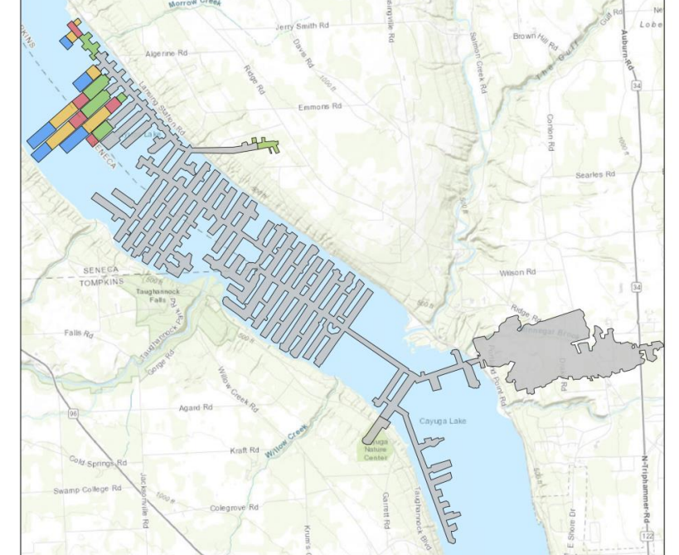
Cargill plans to mine north along Cayuga Lake
CAES facility could plausibly be built on east shore using mines beneath
Figure 9. Map of the Cargill Salt Mine from 2018^{[14].}
Notes:
Reynold

Slide 17
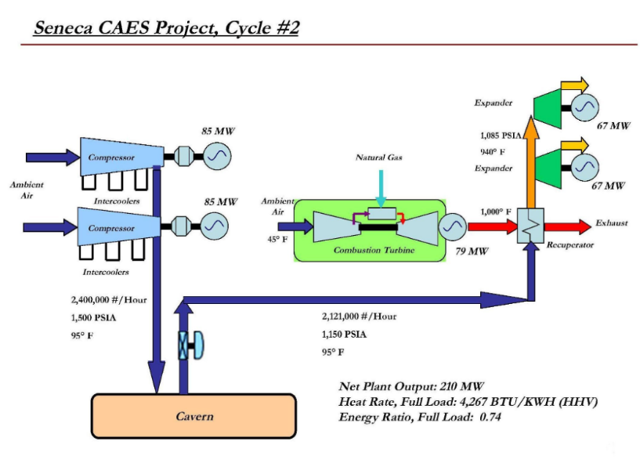
Seneca Lake CAES proposal
New York Electric & Gas (NYSEG) considered a D-CAES facility at Seneca Lake in 2011^{[15]}
Project found to be technically feasible but projected capital costs were too high
Three separate processes were examined: referred to as Cycle 1, 1A, and 2
Process would have made use of salt mines
Storage volume of 425,000 m³, similar existing facilities
Table 3. Proposed D-CAES processes for Seneca Lake.
Process Variable | Cycle 1 | Cycle 1A | Cycle 2
Nameplate Power Capacity (MW) | 136 | 210 | 210
Compressor Rated Power (MW) | 170 | 170 | 170
Energy Storage Capacity (MWh) | 3,124 | 3,124 | 3,124
Storage Pressure (bar) | 55-103 | 55-103 | 79-103
Overall Process Efficiency (%) | 47.9 | 48.9 | 46.5
Capital Cost ($) | 445.273M | 497.178M | 494.148M
Max Capital Cost for NPV=0 ($) | 170.062M | 225.737M | 233.194M
Figure 10. Process Flow Diagram of proposed D-CAES process for Seneca Lake (Cycle 2)^{[15]}.
Notes:
Jimmy

Slide 18
Safety Concerns
Cyclic rapid injection and withdrawal of compressed air during a CAES process can exacerbate issues with cavern stability
Will cause fluctuations in temperature and pressure
In general, rock salt provides several advantages that address safety concerns^{[11,16]}
Low permeability decreases risk of leakage
Self-healing ability can close microfractures
High thermal conductivity dissipates heat quickly during injection
Elastoplastic properties maintain structural integrity even with pressure fluctuations
In the case of a roof collapse, the Seneca and Cayuga salt mines are at sufficient depth (700 m) such that a sinkhole will not form^{[17]}, albeit this may cause a CAES facility to no longer function as intended
Subsidence, the sagging of bedrock above the cavern over time, may be an issue
Can alter groundwater/brine pathways which can further weaken structural integrity
Notes:
Reynold

Slide 19
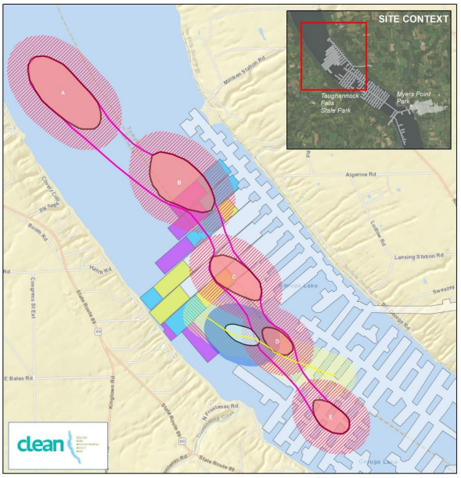
Frontenac Point Anomaly and points A-E are anomalous points of thinner bedrock
Above the mines, the shaded areas represent 1,000 ft buffer zone
Figure 11. Anomalies above the Cayuga Salt Mines^{[17]}.
Notes:
Reynold

Slide 20
Environmental and Community Concerns
Collapse of mine would have environmental effects as well
Link between salt bed and lake will increase salinity, negatively affecting the lake ecosystem
Community members have expressed concerns in decreased property value
If underground pathways for groundwater are altered, it may decrease its availability^{[18]}
Reduced local water levels and deteriorating water quality
In 2013, Crestwood planned to store petroleum in salt caverns beneath Seneca Lake^{[19,20,21]}
Severe public backlash due to various safety, environmental, and economic concerns, the plan was formally rejected in 2018
Notes:
Reynold

Slide 21
NYS Energy Needs

Slide 22
NYS Energy Needs
The New York Independent System Operator (NYISO) indicated that the 2021 NY base load was about 12 GW^{[22,23]}
Coincident peak demand: 30.9 GW in the summer, 23.2 GW in the winter
By 2030, these will reach 31.7 and 31.7 GW, respectively
By 2050, these will reach 35.3 and 44.6 GW, respectively
As of 2022, nameplate capacity in New York Control Area (NYCA) was 1,818 MW for wind and 52 MW for solar
Wind capacity factor of 25.7%
Planned projects will increase capacity, adding 10,158 MW of wind power and 7,109 MW of solar power
Energy storage needed for use alongside wind and solar
NYISO predicts that by 2030, energy storage capacity will reach 4,314 MW for wholesale
By 2050, NY wholesale energy storage capacity is predicted to reach 10,607 MW
Currently 1,409 MW of Pumped Hydro Storage (PHS) in NYS, with average capacity factor 5.8%
Notes:
Reynold?

Slide 23
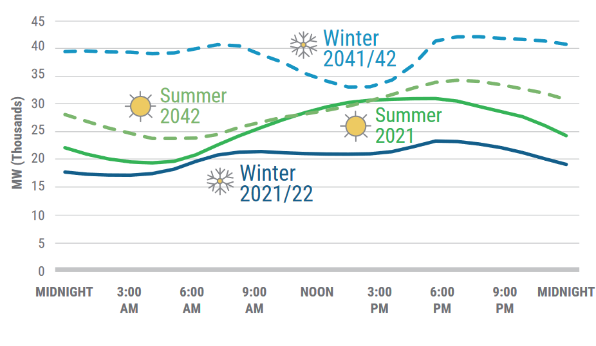
Example load curve for a typical day in NY
Figure 12. 2021 Actual and 2042 Forecasted Winter/Summer Load Curves. In Zone E of NYCA (Mohawk Valley)^{[23]}.
Notes:
Reynold?
Talk about what times would be ideal to charge a CAES facility, what times to discharge

Slide 24
Recommendation and Comparison

Slide 25
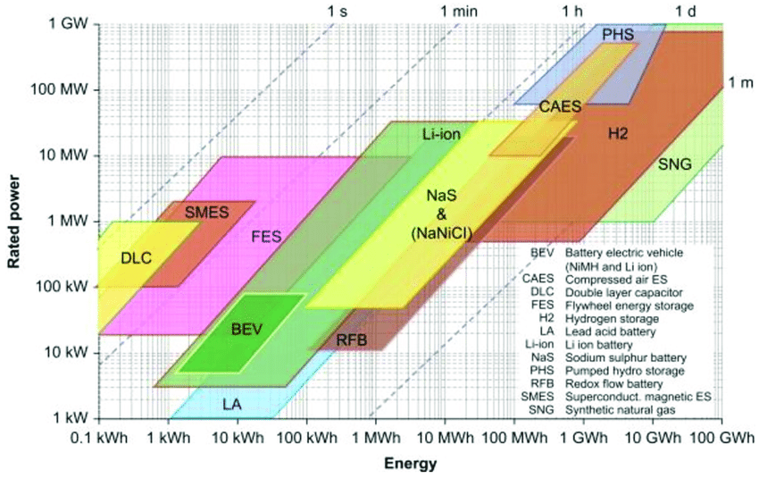
Comparison of Energy Storage Technologies
CAES has very high power and energy capacity
Rivaled only by Pumped Hydro Storage (PHS) and Hydrogen
CAES also has rather low capital costs and long lifetime
PHS by far represents the most common type of energy storage currently
In the US, there is 23.7 GW PHS versus 110 MW CAES
Table 4. Comparison of efficiency, lifetime, and capital costs of select energy storage technologies^{[24,25,26,27]}.
Figure 13. Comparison of energy storage technologies in storage capacity and rated power^{[28}].
Storage Type | Efficiency (%) | Lifetime (years) | Power cost ($/kW) | Energy Cost ($/kWh)
CAES | 40-70 | 35-45 | 400-800 | 1-50
PHS | 70-90 | 30 | 2100-4300 | 5-80
Lead Acid Battery | 70-80 | 4-8 | 1740–2580 | 300-500
Lithium Ion Battery | 90 | 15 | 100-200 | 100-300
NaS Battery | 60-80 | 15 | 1850-2150 | 300-500
Flywheel | 90 | 20 | 3700-4300 | 1340-1570
Notes:
Jimmy?

Slide 26
Recommendation
We propose an A-CAES facility for the Cayuga Lake salt mines
A-CAES is best type of CAES for NYS given the state’s focus on zero emission electricity
Based on scaled up version of “process 5” simulation
Five compressor and turbine trains in parallel
Similar to planned Gem Energy Storage Facility
About 10% of total mine volume would be utilized
Advantages
No need to build new caverns
Potentially very high energy storage capacity
Table 5. Summary of our proposed A-CAES facility on Cayuga Lake.
Process Variable | Value
Nameplate Power Capacity (GW) | 1.5
Compressors Rated Power (GW) | 1.2
Total Energy Storage Capacity (GWh) | 23.9
Discharge Time (hours) | 16
Storage Volume (m³) | 5,000,000
Operating Pressure (bar) | 40-70
Overall Process Efficiency (%) | 61.6
Notes:
Jimmy

Slide 27
Economic Analysis
The proposed A-CAES facility was compared to a PHS facility with equal nameplate capacity and energy storage capacity
Capital costs and levelized costs of electricity (LCOE) were estimated for the two proposed facilties using figures from Table 4 and the literature^{[29]}
A-CAES is competitive to PHS in terms of LCOE
This is even when taking into account the likely lower discount rate for PHS, due to its increased technological maturity
Table 6. Costs of our proposed A-CAES facility and equivalent PHS facility.
Cost | A-CAES | PHS
Total Capital Cost | $1.85B | $4.25B
Operating Costs | $30M/yr | $27M/yr
LCOE, r=0.05 | $61/MWh | $122/MWh
LCOE, r=0.075 | $80/MWh | $164/MWh
LCOE, r=0.10 | $99/MWh | $209/MWh
LCOE, r=0.125 | $120/MWh | $256/MWh
LCOE, r=0.15 | $141/MWh | $304/MWh
Notes:
Jimmy

Slide 28
Conclusions
NYS will soon need significantly more energy storage due to planned expansions in variable renewable generation
CAES presents an approach to meet this need
CAES has several advantages over other energy storage technologies
High power generation and energy storage capacities
Long storage duration
Low capital costs, especially for salt caverns
Long lifetimes and high reliability
The Finger Lake Salt mines present an ideal storage vessel for CAES
Very high volume available
Salt mines ideal choice for storage over other geology
We have proposed a A-CAES facility for Cayuga Lake
1.5 GW, 23.9 GWh
Capital costs ~$1.85B, similar or better LCOE to comparable PHS facility
Notes:
Both of us?

Slide 29
References
Our progress. (n.d.). NYSERDA. Retrieved December 1, 2022, from https://climate.ny.gov/Our-Progress
Hadjipaschalis, I., Poullikkas, A., & Efthimiou, V. (2009). Overview of current and future energy storage technologies for electric power applications. Renewable and Sustainable Energy Reviews, 13(6), 1513–1522. https://doi.org/10.1016/j.rser.2008.09.028
Lund, H., & Salgi, G. (2009). The role of compressed air energy storage (Caes) in future sustainable energy systems. Energy Conversion and Management, 50(5), 1172–1179. https://doi.org/10.1016/j.enconman.2009.01.032
Luo, X., Wang, J., Dooner, M., Clarke, J., & Krupke, C. (2014). Overview of current development in compressed air energy storage technology. Energy Procedia, 62, 603–611. https://doi.org/10.1016/j.egypro.2014.12.423
Budt, M., Wolf, D., Span, R., & Yan, J. (2016). A review on compressed air energy storage: Basic principles, past milestones and recent developments. Applied Energy, 170, 250–268. https://doi.org/10.1016/j.apenergy.2016.02.108
He, W., & Wang, J. (2018). Optimal selection of air expansion machine in Compressed Air Energy Storage: A review. Renewable and Sustainable Energy Reviews, 87, 77–95. https://doi.org/10.1016/j.rser.2018.01.013
Heidari, M., Mortazavi, M., & Rufer, A. (2017). Design, modeling and experimental validation of a novel finned reciprocating compressor for Isothermal Compressed Air Energy Storage applications. Energy, 140, 1252–1266. https://doi.org/10.1016/j.energy.2017.09.03
Huntorf more than 20 years—Club des argonautes | e-nautia. (n.d.). Retrieved November 6, 2022, from https://e-nautia.com/clubargon/disk?p=8631946
Foley, A., & Díaz Lobera, I. (2013). Impacts of compressed air energy storage plant on an electricity market with a large renewable energy portfolio. Energy, 57, 85–94. https://doi.org/10.1016/j.energy.2013.04.031
Lemofouet-Gatsi, S. (2006). Investigation and optimisation of hybrid electricity storage systems based on compressed air and supercapacitors. EPFL.
Luo, X., & Wang, J. (2013). OVERVIEW OF CURRENT DEVELOPMENT ON COMPRESSED AIR ENERGY STORAGE.
July 09, ohtadmin | on & 2019. (2019, July 9). History of salt fields of cayuga lake watershed—Tompkins weekly. Tompkins Weekly -. https://www.tompkinsweekly.com/articles/history-of-salt-fields-of-cayuga-lake-watershed/
Cayuga rock salt mine. (n.d.). Retrieved December 5, 2022, from https://www.americanindustrialmining.com/cayuga-rock-salt-mine
Map viewer. (n.d.). Retrieved December 5, 2022, from https://www.arcgis.com/apps/mapviewer/index.html?webmap=c2e7ff4ab0424003b9fa5867459effad
None, N. (2012). Seneca compressed air energy storage (Caes) project. New York State Electric & Gas Corporation, NY (United States). https://doi.org/10.2172/1088675
Fazaeli, M. M. (2017). Stability Assessment of Salt Cavern Roof Beam for Compressed Air Energy Storage in South-Western Ontario. University of Waterloo. https://uwspace.uwaterloo.ca/bitstream/handle/10012/12586/Fazaeli_Mohammad_Mahdi.pdf?sequence=1&isAllowed=y
Voegeli, Sam. (2021). “Geomechanics of Cavern Storage” Retrieved December 5, 2022.
Mantius, P. (2021, July 19). As risks of a catastrophic mine flood under cayuga lake mount, cuomo’s dec guards cargill’s secrets. Water Front- Peter Mantius. https://waterfrontonline.blog/2021/07/19/as-risks-of-a-catastrophic-mine-flood-under-cayuga-lake-mount-cuomos-dec-guards-cargills-secrets/
Businesses oppose gas storage in seneca lake salt caverns | new york sustainable business council. (n.d.). Retrieved December 5, 2022, from https://nyssbc.org/businesses-oppose-gas-storage-in-seneca-lake-salt-caverns/
Crestwood’s Seneca Lake propane storage facility rejected by DEC. (n.d.). Albany Bureau. Retrieved December 5, 2022, from https://www.pressconnects.com/story/news/2018/07/12/dec-rejects-plan-crestwood-propane-storage-facility-seneca-lake/779605002/
Site, O. (n.d.). About crestwood. We Are Seneca Lake. Retrieved December 5, 2022, from https://www.wearesenecalake.com/about-inergy/

Slide 30
References (Cont.)
“Gold Book: 2022 Load and Capacity Data.” New York Independent System Operator. April 2022. Retrieved September 8, 2022 from https://www.nyiso.com/documents/20142/2226333/2022-Gold-Book-Final-Public.pdf/cd2fb218-fd1e-8428-7f19-df3e0cf4df3e
“Power Trends 2022.” New York Independent System Operator. Retrieved September 8, 2022 from https://www.nyiso.com/documents/20142/2223020/2022-Power-Trends-Report.pdf/d1f9eca5-b278-c445-2f3f-edd959611903?t=1654689893527
Inage, S.-I. (2009). Prospects for Large-Scale Energy Storage in Decarbonised Power Grids. International energy agency. https://iea.blob.core.windows.net/assets/6bb67be5-0b74-403f-ac02-395c3f3a0762/energy_storage.pdf
Rastler, D. (n.d.). Overview of Electric Energy Storage Options for the Electric Enterprise. Electric Power Research Institute. https://www.greentechmedia.com/images/wysiwyg/News/EPRIEnergyStorageOverview%20DanRastler.pdf
Schoenung, Susan & Hassenzahl, William. (2003). Long-vs. Short-Term Energy Storage Technologies Analysis A Life-Cycle Cost Study A Study for the DOE Energy Storage Systems Program. Sandia Report SAND.
Worldwide—Lithium ion battery pack costs. (n.d.). Statista. Retrieved December 5, 2022, from https://www.statista.com/statistics/883118/global-lithium-ion-battery-pack-costs/
Bignucolo, F., Caldon, R., Coppo, M., Pasut, F., & Pettinà, M. (2017). Integration of lithium-ion battery storage systems in hydroelectric plants for supplying primary control reserve. Energies, 10(1), 98. https://doi.org/10.3390/en10010098
Mongird, K., Viswanathan, V., Alam, J., Vartanian, C., Sprenkle, V., & Baxter, R. (2020). 2020 Grid Energy Storage Technology Cost and Performance Assessment. https://www.pnnl.gov/sites/default/files/media/file/Final%20-%20ESGC%20Cost%20Performance%20Report%2012-11-2020.pdf

Slide 31
Backup Slides

Slide 32
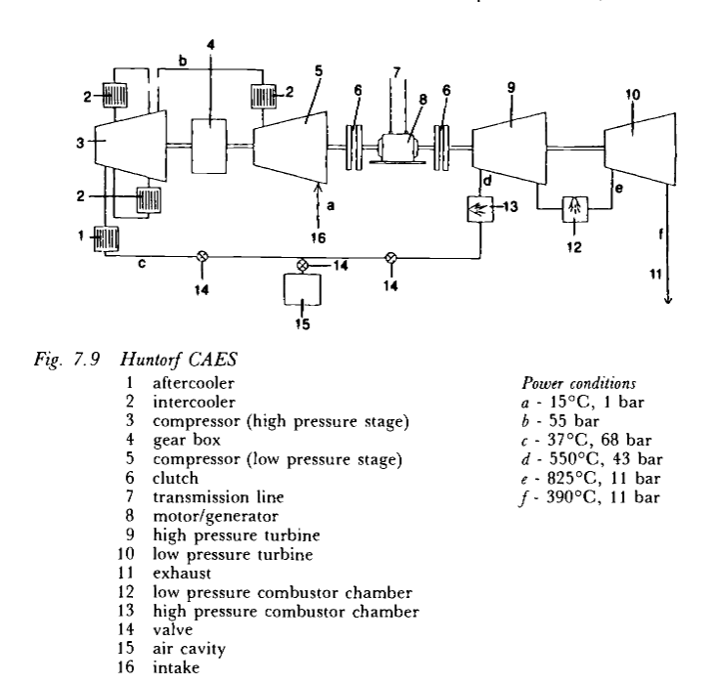
Huntorf PFD
Figure 14. Process Flow Diagram of Huntorf CAES facility.

Slide 33
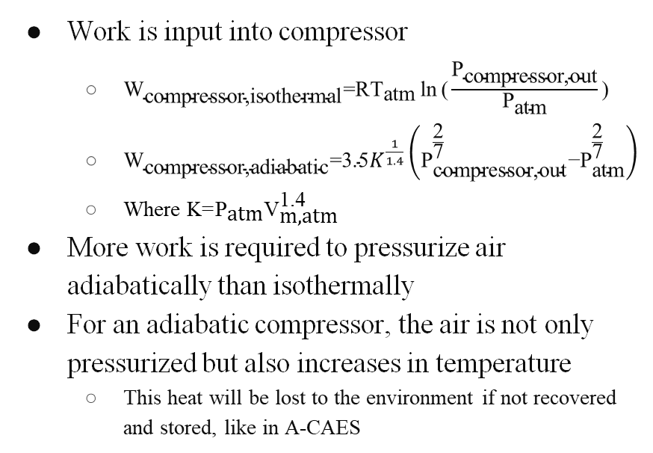
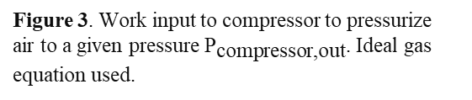
Analysis
Work is input into compressor
${\text{W}}_{\text{compressor}\text{,}\text{isothermal}}\text{=}\text{R}{\text{T}}_{\text{atm}}\text{ln}{\text{(}\frac{{\text{P}}_{\text{compressor}\text{,}\text{out}}}{{\text{P}}_{\text{atm}}}\text{)}}$
${\text{W}}_{\text{compressor}\text{,}\text{adiabatic}}\text{=}\text{3.5}K^{\frac{1}{1.4}}\left({\text{P}}_{\text{compressor}\text{,}\text{out}}^{\frac{\text{2}}{\text{7}}}\text{−}{\text{P}}_{\text{atm}}^{\frac{\text{2}}{\text{7}}}\right)$
Where $\text{K}\text{=}{\text{P}}_{\text{atm}}{\text{V}}_{\text{m}\text{,}\text{atm}}^{\text{1.4}}$
More work is required to pressurize air adiabatically than isothermally
For an adiabatic compressor, the air is not only pressurized but also increases in temperature
This heat will be lost to the environment if not recovered and stored, like in A-CAES
Figure 3. Work input to compressor to pressurize air to a given pressure ${\text{P}}_{\text{compressor}\text{,}\text{out}}$. Ideal gas equation used.
Figure 4. Outlet temperature of air from adiabatic compression.
Notes:
Jimmy

Slide 34
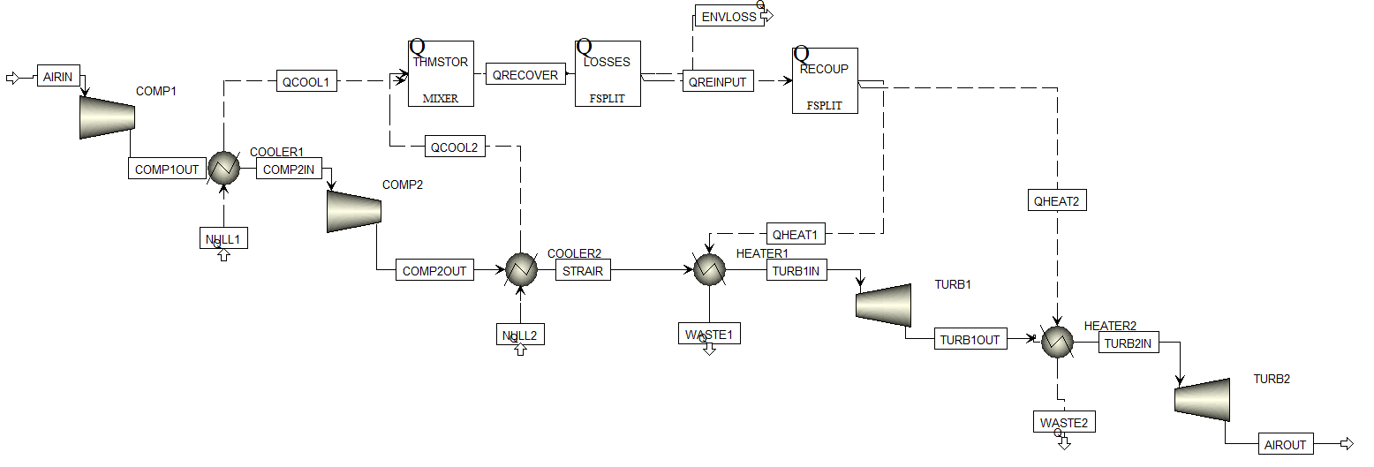
Process Simulation PFD
Compressor Train has a low- and high-pressure compressor
Cooler after each
Turbine train as a high- and low-pressure turbine
Heater before each
Thermal energy storage system with some loss fraction
Figure 15. Process Flow Diagram of simplified A-CAES process in Aspen Plus V11.

Slide 35
Environmental and Community Concern
Collapse of mine will have environmental effects as well
Link between salt bed and lake will increase salinity, negatively affecting the lake ecosystem
Community members have expressed concerns in decreased property value
If underground pathways for groundwater are altered, it may decrease its availability
Reduced local water levels and deteriorating water quality
In 2013, Crestwood planned to store petroleum in salt caverns beneath Seneca Lake
Severe public backlash due to concerns over leaks of brine and gas from the caverns, explosions and other catastrophic accidents, contaminated drinking water, impacts on tourism and the local wind industry, expansion of hydrofracking, and climate change
Notes:
Reynold

Slide 36
Regulation
Land beneath Cayuga Lake is owned by the state
A permit from the NY Dept of Environmental Conservation is necessary
Mines owned by Cargill Inc
Negotiations must be made with Cargill
Notes:
Reynold

Slide 37
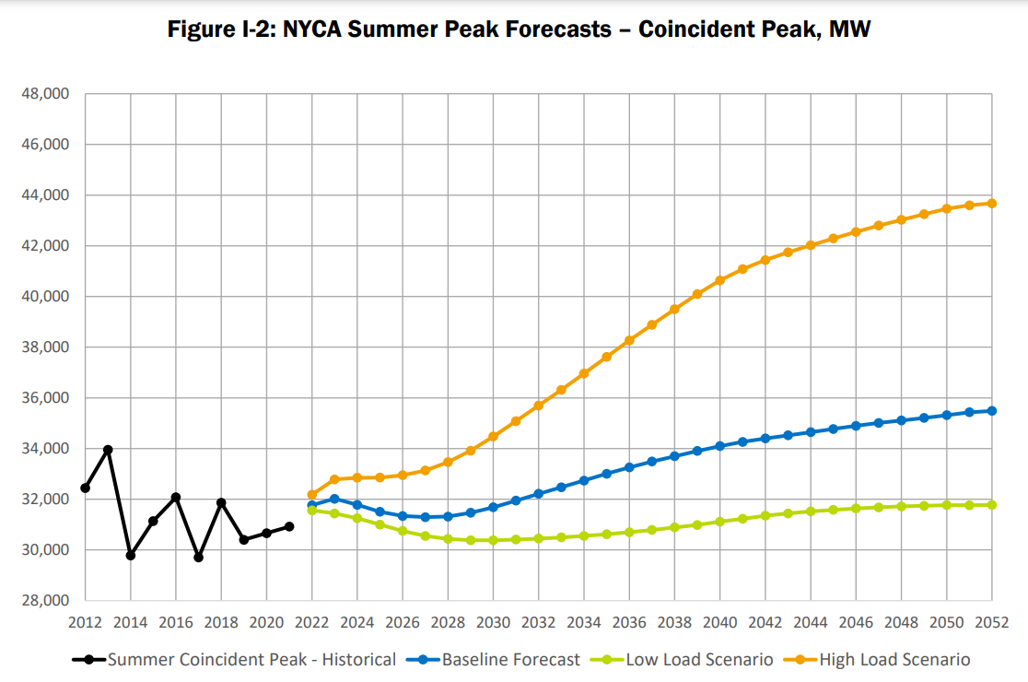

Slide 38
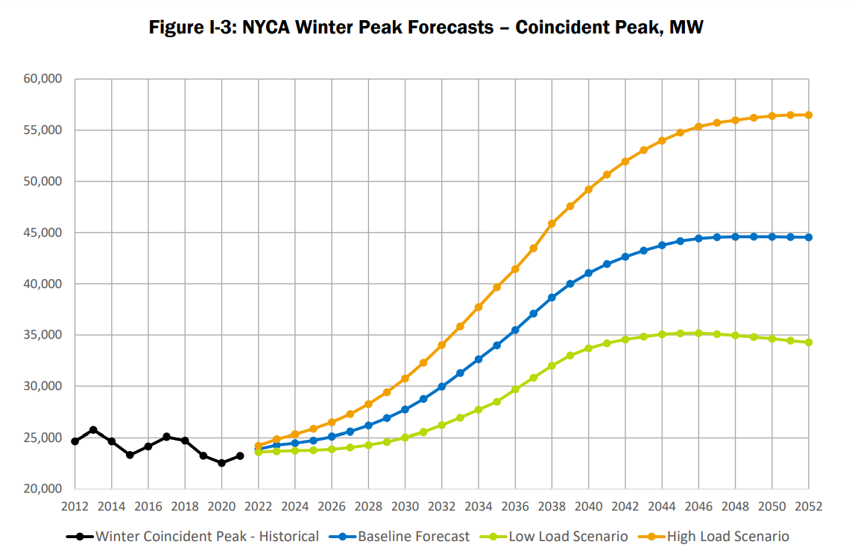

Slide 39
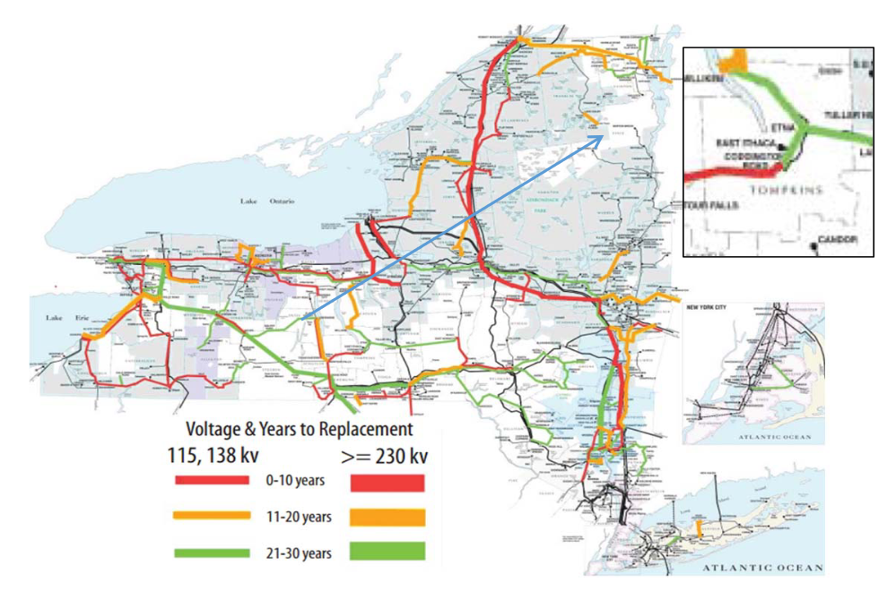
Transmission
Only a few significant transmission lines around Cayuga Lake
A CAES facility would require upgrades to this infrastructure
Figure 18. Transmission lines in NYS and around Cayuga Lake.
Notes:
Reynold

